Slide 1
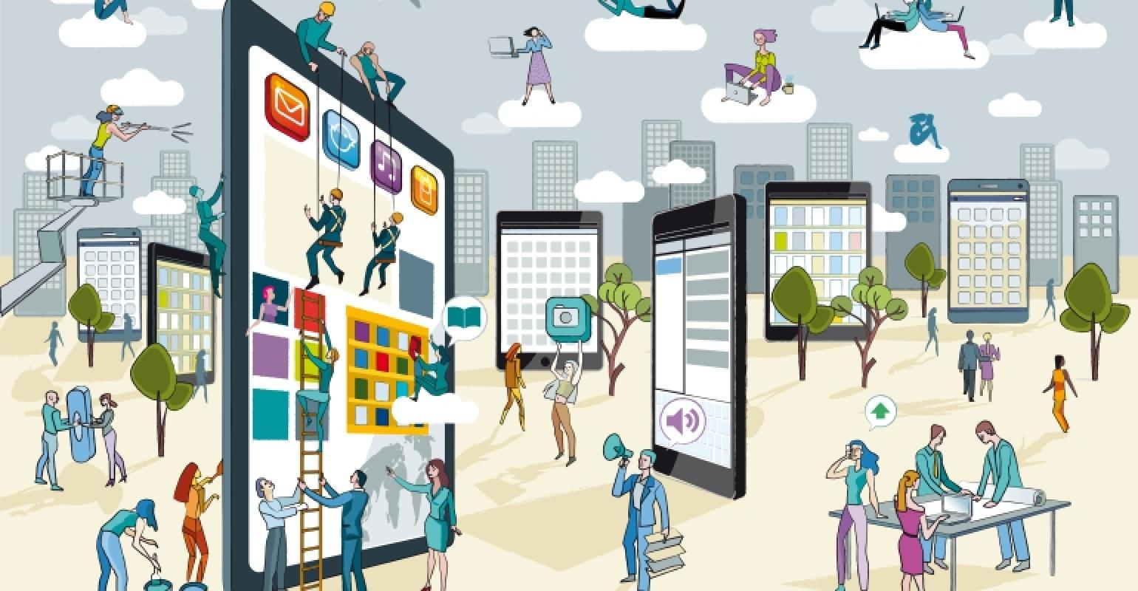
Interaction between Humans and Technology

Slide 2

How has Technology affected YOU?
All Technology has a profound affect on all of us.
Can you outline some of the pros and cons of technology?

Slide 3
Technology has many benefits but at the same time it can have negative consequences.
Technology affects our society significantly
For example, the computer might be considered the greatest invention ever (next to the telephone and light bulb) and we are constantly finding new ways to improve it.
Computers influence many aspects of our lives, including: medicine, communications, mathematics, entertainment, business, agriculture, and all other sciences.
How do you use computers today?

Slide 4
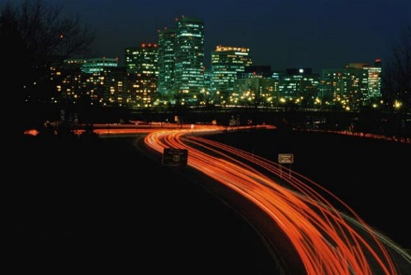
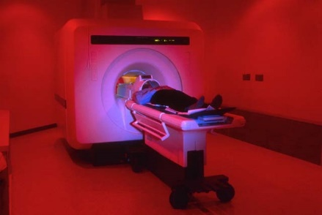


Technology and Science
Science and technology have had both a positive and negative impact on society, especially in the following areas:
Community Life
Health
Communication
Work

Slide 5
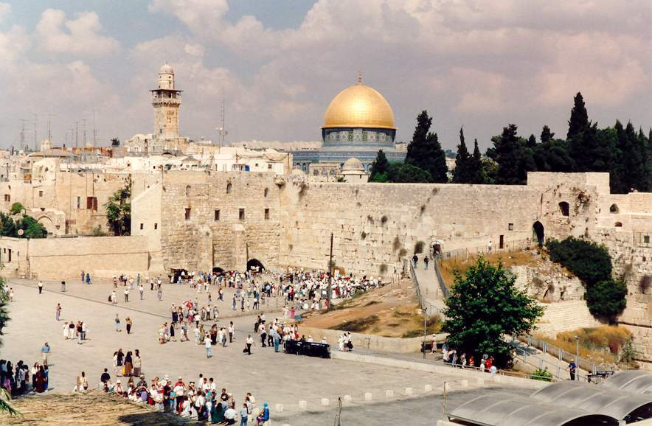
Community Life
The shift from nomadic life to farming led to the development of the city.
Networks of transportation, communication, and trade systems
Specialized labor
Government and religion
Social class
Jerusalem, one of the world’s first cities, is still in existence today.

Slide 6
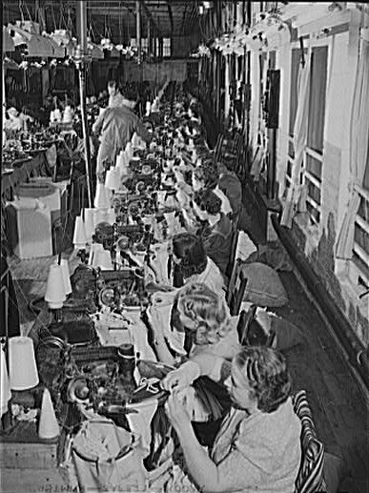
Community Life
The nineteenth century witnessed the Industrial Revolution.
Invention of textile manufacturing machines
Division of labor
Increase in production
Crowded cities
Unsafe and unhealthy working conditions
Some of the negative aspects of the Industrial Revolution included poor working conditions and long hours.

Slide 7
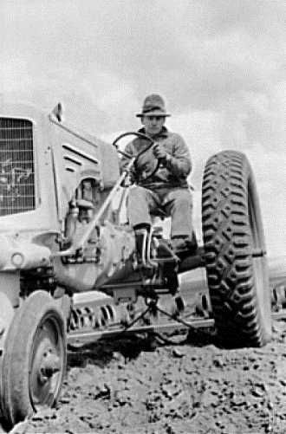
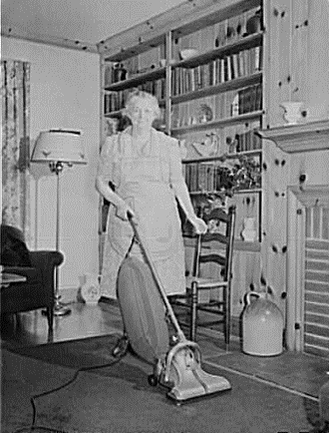
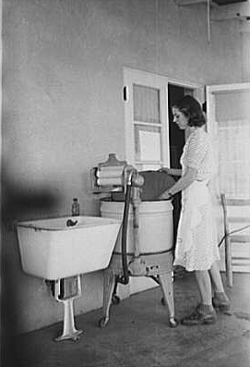
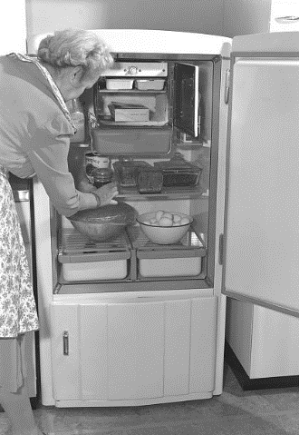
Work
Technical innovations saved physical energy and lessened people’s workload.
The tractor
The vacuum cleaner
The washing machine
The refrigerator

Slide 8
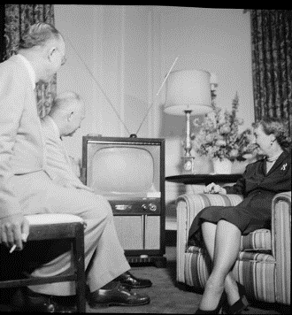
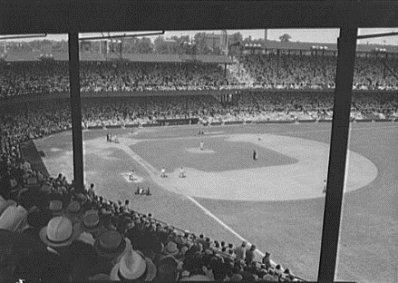
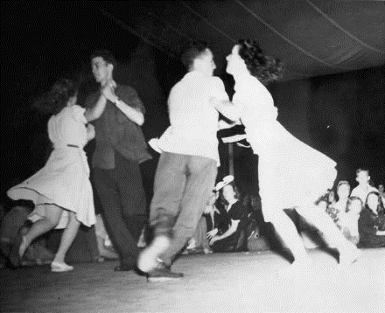
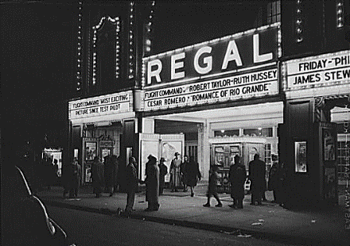
Work
(Continued)
The concept of leisure developed from labor-saving technology. People use the money they earn to take advantage of leisure time.
Sporting Events
Television
Movies
Social Activities

Slide 9
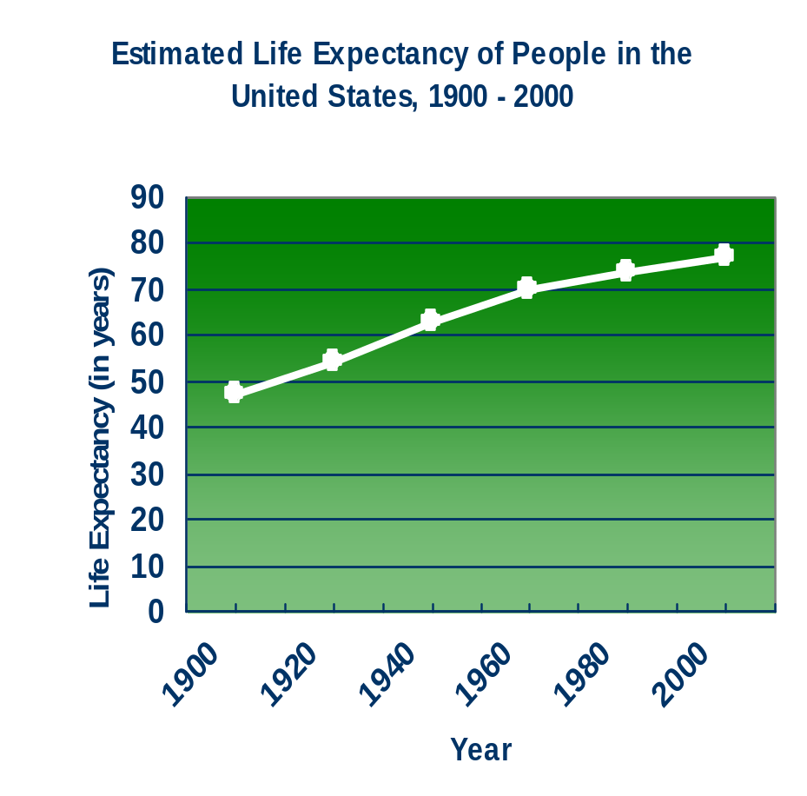
Health
The greatest innovation of technology was longevity.

Slide 10
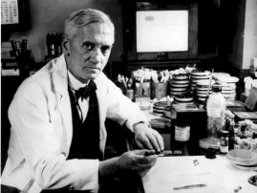
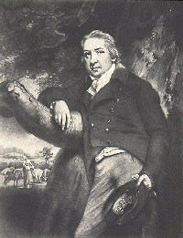
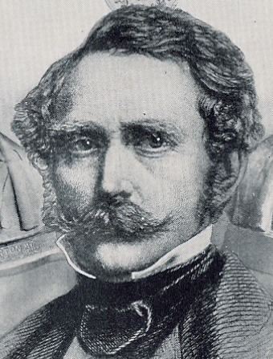
Health
A large part of technology has been dedicated to the advancement of medical science.
Sir Alexander Fleming discovered penicillin, the first antibiotic, in 1928.
In 1796, Edward Jenner paved the way for modern immunology by discovering a vaccine for smallpox.
Dr. William Thomas Green Morton (c. 1846) was one of the first medical practitioners to use anesthesia on a patient before performing surgery.

Slide 11
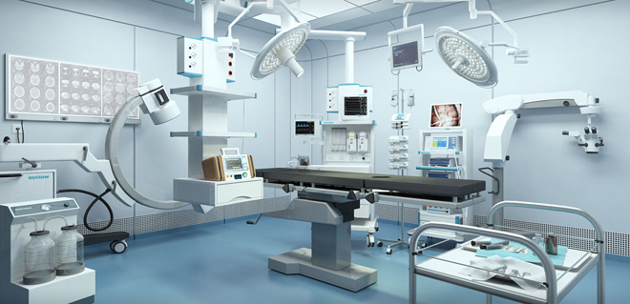
Health
A large part of technology has been dedicated to the manufacture of medical equipment

Slide 12
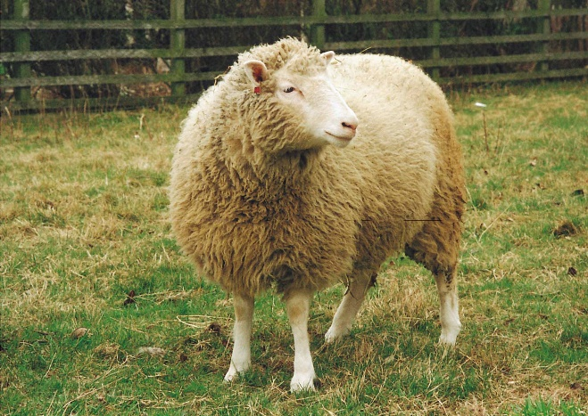
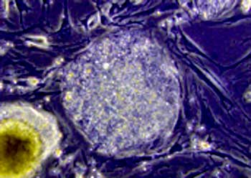
Health
Some current innovations could have a drastic impact on society.
In 1997, scientists at the Roslin Institute in Edinburgh, Scotland, introduced Dolly the sheep, the first mammal ever to have been cloned. Dolly quickly became the symbol of the controversy over the ethics of cloning.
Embryonic stem cell research is another area that is at the center of controversy. While stem cells might be able to be used to generate new organs for transplant, the use of them has many ethical considerations.

Slide 13
Education
Internet
  Classrooms
  Library
  Web Quests
Online tests
Computer-Based Learning
Distance Learning
Definition: using technology, the Internet, as a medium for schooling or learning

Slide 14
Global Economy
Banking, finance, commerce (printed money is on its way to becoming obsolete)
  Affects the way information and money is transmitted
Electronic commerce: having an online business
  Buy
  Sell
  Internet speed will increase because of cable modems and DSL
  Digital cash

Slide 15
Communication
Inventions and innovations in communication have had a major influence on society.
Printing press
Telephones
Fax machines
World Wide Web

Slide 16
INTERNET
A FORCE FOR GOOD OR EVIL?

Slide 17
Internet
The world’s largest computer network
Inventor of the worldwide web, Tim Berners-Lee, turned on the first web server in Geneva in 1990 on Christmas Day.
Over 3.6 bn people are online worldwide; 2 bn of them are monthly users on Facebook, the social network.

Slide 18
Internet
Every minute, 24 hours-worth of video is uploaded to YouTube
Huge numbers of people across the world shop, communicate, work and date through the Internet
It is a key driver of globalization (creating a global village)

Slide 19
Internet
Cyberspace is where many people across the world spend most of their time
For many, especially younger people, the virtual world is seen as more interesting than the ‘real world’
In 2018 many senior police officers express concern that online content on social media sites like Snapchat is helping fuel a knife crime and gun epidemic in London and other UK cities
Online music sites glorify the ‘cool’ of violence and children as young as twelve traffic drugs using encrypted mobile phone communication

Slide 20
Internet
While computers are beneficial to us we depend on them too much; this makes us vulnerable to computer hackers who seek to destroy all we have created.
What about inappropriate web sites? Chat rooms? These can also be negative.

Slide 21
What is the internet doing to us?
It is bringing us all together via social networks and online interaction, creating a ‘global village’
It is also isolating individuals and groups, creating a divided world between the ‘information rich’ and the ‘information poor’
We have created a world beyond our own understanding by delegating to machines so many human choices
While the Internet’s ability to spread news and images helped fuel the ‘Arab Spring’ pro-democracy protest movement in 2011-2012 across the Middle East, the very same technology allows for the spread of far-right propaganda or Jihadi recruiting messages from Isis

Slide 22
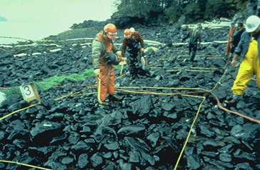
Progress
Progress is a series of improvements in human life marked by inventions and discoveries.
Positive attributes of technology must be greater than negative attributes
Negative consequences: destruction of environment and loss of what it means to be human
The Exxon Valdez oil spill off the coast of Alaska in 1989 impacted 1,300 miles of shoreline and killed an enormous amount of wildlife.

Slide 23
Summary
Many people predict that technology will change the entire structure of education.
Technology is having a tremendous impact on education.
The Internet and the World Wide Web are the biggest factors affecting education today.
Online courses through the Internet are becoming very popular.
Many schools use computer-based learning to reinforce concepts.
Genetic engineering refers to changing the DNA in a living organism.

Slide 24
Summary
Virtual reality is an artificial environment that feels like a real environment and is used in education, training, medicine, research, and other areas.
In the new global economy, knowledge is the greatest asset.
Electronic commerce is the buying and selling of goods and services using the Internet and is predicted to grow at an ever-increasing rate.
Digital cash allows someone to pay online by transmitting a number from one computer to another.
New jobs and new job categories are being developed because of the Internet and electronic commerce.

Slide 25
References
Chapter 9: Science, Technology, and Society. Copyright © 2006 by the McGraw-Hill Companies, Inc.

